Slide 1

Biomechanics Of Shoulder Joint
Dr. Zaid Jafar Al-Bachachy
Orthopedic & Trauma
Surgeon
1st October 2023

Slide 2
SHOULDER
The shoulder demonstrates the greatest range of motion of any joint in the body.
Complex biomechanical principles control its multiplanar range of movement.
The resultant high degree of freedom and lower level of constraint may lead to an increase in the development of pathological conditions.
A balance is required between mobility and range of motion versus stability required to generate power within the joint and stabilize the arm in space.
Understanding the biomechanics is essential in order to contend with the treatment of these conditions and the challenge of design and development of joint replacement prostheses

Slide 3
Anatomy
The shoulder is a complex of three articular joints and two physiological joints.
The articular joints include the glenohumeral (GHJ), acromioclavicular and sternoclavicular joints.
The physiological joints include the scapulothoracic joint and subacromial joint (between the rotator cuff and inferior surface of the acromion).
The individual osseous components have specific anatomical configurations and soft-tissue attachments to optimize function.

Slide 4
Glenoid and scapular orientation.

Slide 5
Humerus
The humerus is composed of the head, neck (surgical and anatomical) and the shaft.
The head is superiorly inclined and eccentrically placed in relation to the shaft, with a neck–shaft angle of around 130–140° and positioned 9 mm posterior to the central shaft axis, respectively.
It is retroverted by around 30° in relation to the trans-epicondylar axis.
The angle of inclination, posterior offset and version must be replicated during prosthetic replacement to achieve optimal biomechanics and limit early failure.

Slide 6
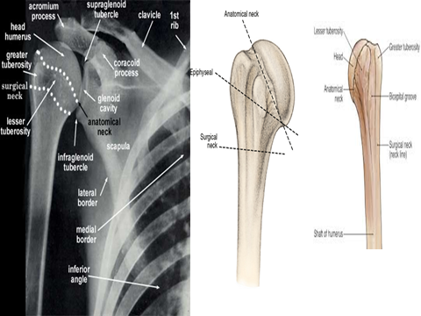

Slide 7
Scapula and glenoid
The scapula is anteverted 30–40° in relation to the coronal plane.
The glenoid is around 7° retroverted from the plane perpendicular to the scapular plane and demonstrates around 3–5° of superior tilt in relation to the vertical plane.
The surface area of the glenoid is only approximately one-third that of the humeral head.
Joint congruency and thus stability is increased by the distribution of cartilage of the glenoid fossa and the presence of the glenoid labrum.

Slide 8
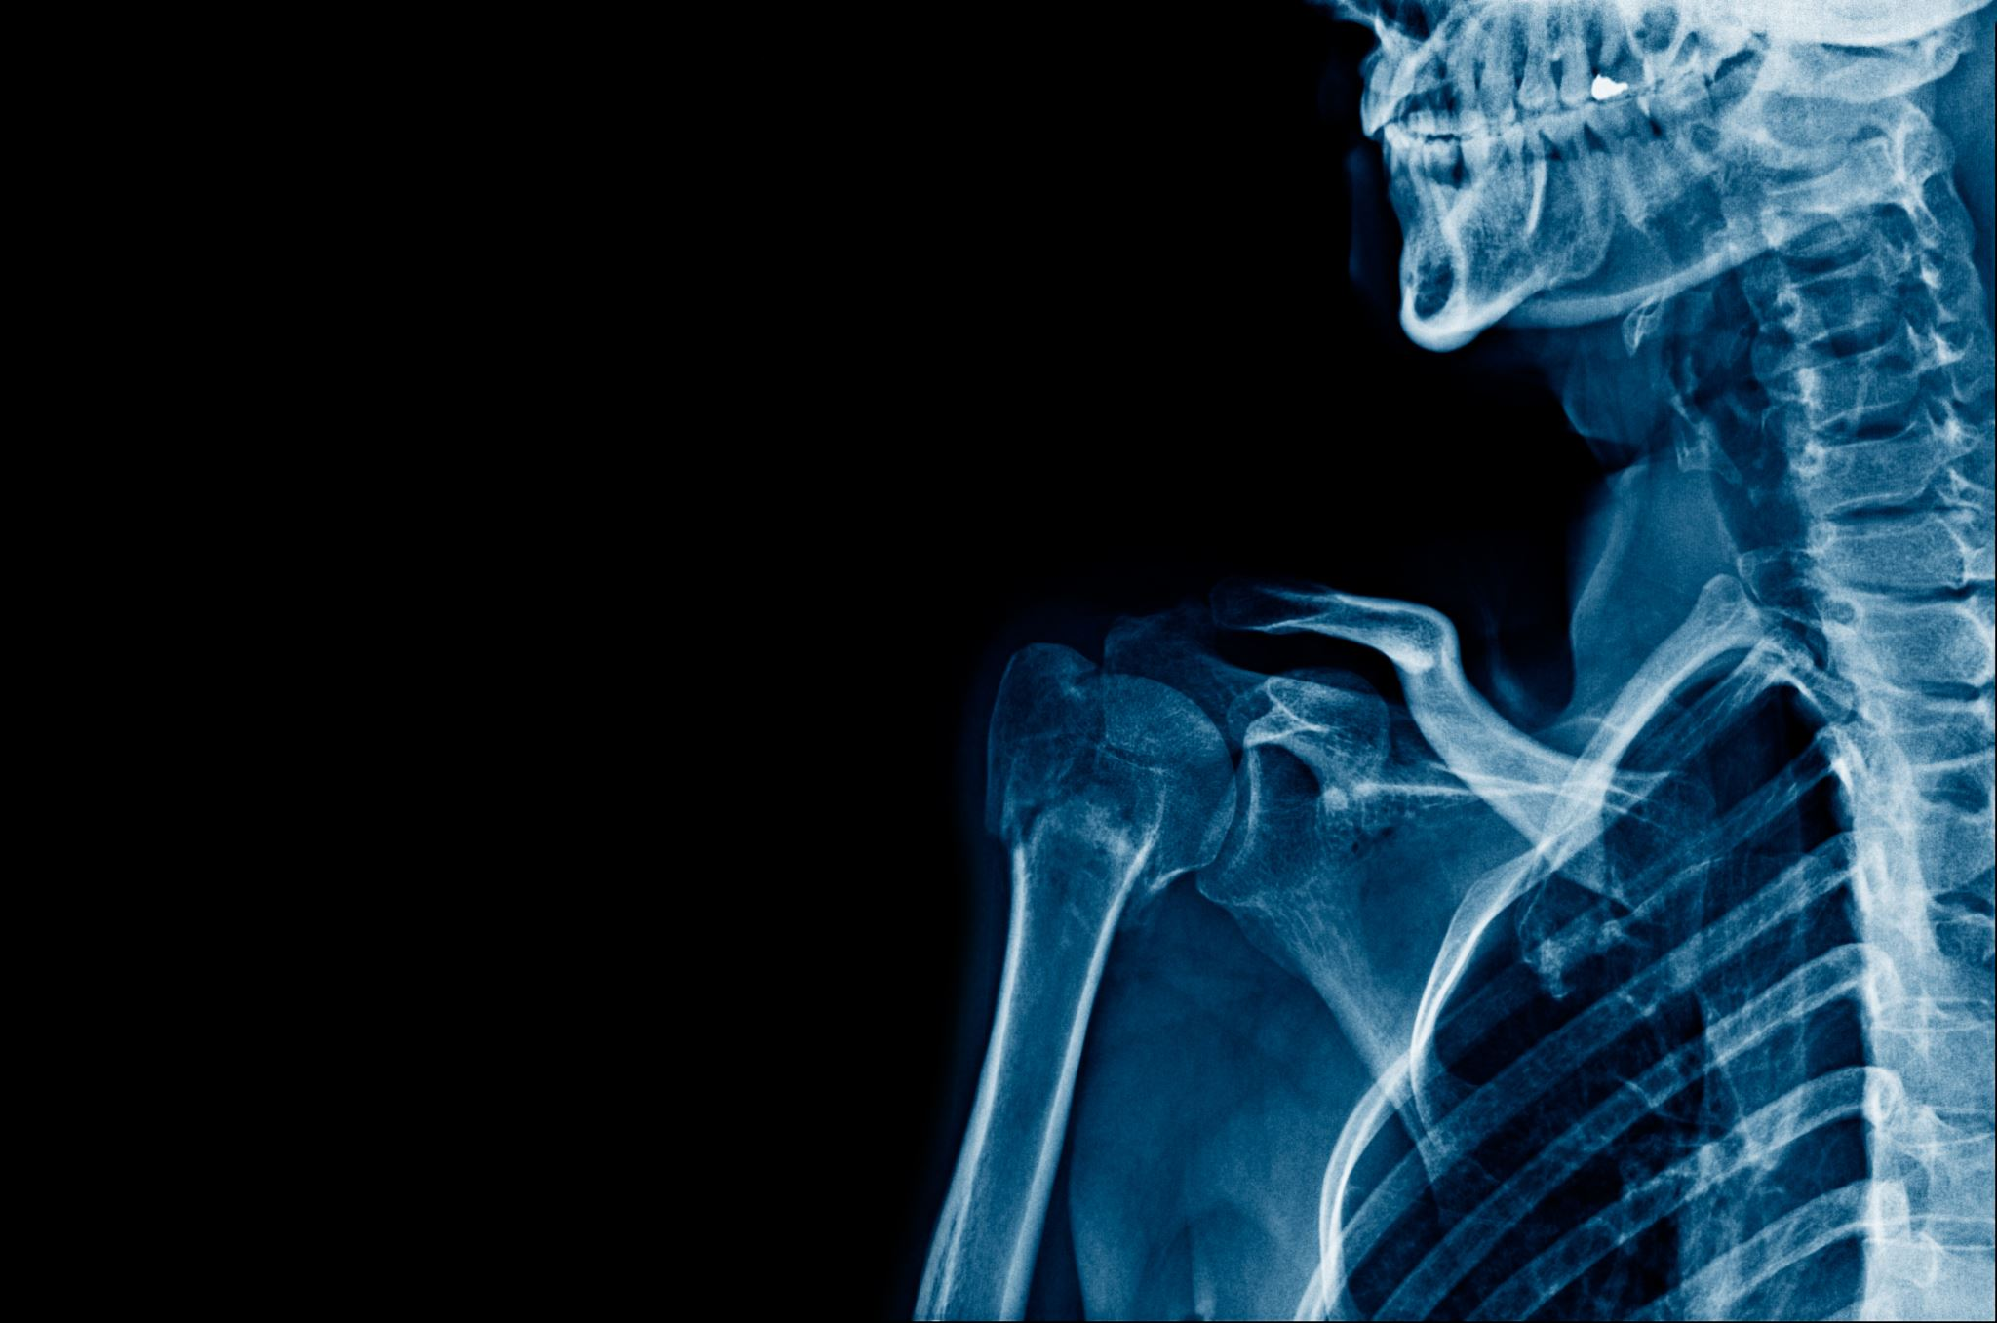
Clavicle
The clavicle functions as a strut suspending the GHJ, maintaining the lateral position of the shoulder, and providing important muscular attachments.
During shoulder movements, the clavicle circumducts around the sternoclavicular joint medially and laterally, and the articulation with the acromion is maintained by the coracoclavicular and acromioclavicular ligaments.
Disruption of these structures leads to destabilization of the scapula, protraction of the shoulder, and scapulothoracic dyskinesia.

Slide 9
Joint movement
Normal shoulder function is reliant on coordinated glenohumeral and scapulothoracic movement.
Failure of normal movement of either joint and/or malcoordination leads to abnormal kinetics and a potential increase in the risk of pathology, such as impingement or instability.
A range of muscles are involved in movements on the shoulder and their action is dependent upon the position of the arm in space at the point of movement.
Muscle-controlling movements can be classified into glenohumeral, scapulothoracic, and thoracohumeral.

Slide 10
Glenohumeral motion
The rotator cuff muscles force the humeral head firmly into the glenoid fossa and minimize humeral head translation.
A cuff deficient shoulder has a significant impact on the glenohumeral articulation.
Forward elevation in the scapular plane involves combined activity of deltoid and supraspinatus creating a vertical shear force, which in the presence of cuff deficiency leads to superior migration of the humeral head.

Slide 11
Deltoid and supraspinatus are also active during shoulder abduction.
Supraspinatus plays a more dominant role in the initiation of abduction whilst deltoid activity increases with elevation of the arm.
The vectors of both muscles equalize at around 90° of abduction.
Thus, patients with a supraspinatus tear may experience pain and weakness around 30° of elevation compared with 90°, where there is greater power, compensation, and recruitment of the deltoid.

Slide 12
Muscles controlling shoulder movement

Slide 13

Scapulothoracic motion
Scapular rotation on the thorax confers important roles:
the glenoid functions as a stable base during arm elevation;
it minimizes the risk of mechanical impingement of the rotator cuff; it preserves the deltoid muscle fibre length;
it limits the degree of humeral head translation;
it maximizes the range of shoulder movement and enables concavity compression of the humeral head into the glenoid throughout the range, allowing optimal transfer of net joint reaction forces through the glenoid fossa.
The humeral head rolls and translates during shoulder movements, up to 11 mm inferiorly during high elevation. Thus, a fixed, rigid glenoid would fail to prevent increasing translation and minimize the range of motion.
Moreover, a malpositioned glenoid may cause instability and impingement.

Slide 14
Scapulothoracic dynamics are important factors in assessing a painful shoulder and it is important to define the relationship between glenohumeral and scapulothoracic movements, and identify any scapulothoracic dyskinesia.
The coordination of glenohumeral and scapulothoracic movements are variable and dependent on the degree of arm elevation.
Zero to 30° of abduction and 60° of forward flexion primarily involves glenohumeral movement. Beyond 30° the ratio of scapulothoracic to glenohumeral movement is 2:1 and beyond 120° the ratio is around 1:1.

Slide 15
a) Muscle forces across the glenohumeral joint at initiation of abduction; b) muscle forces in 90 degrees of abduction; c) muscle forces in presence of weak/deficient cuff

Slide 16
Glenohumeral stability
The GHJ is reliant on the synchronous function of both static and dynamic stabilizing factors.
A combination of structural and functional features provides joint stability at various stages throughout the range of motion (Table).

Slide 17
Static and dynamic factors affecting glenohumeral joint stability

Slide 18
Static factors
The humeral head and glenoid version
Reduced retroversion and abnormal offset of the humeral head and excessive retroversion of the glenoid may have a significant impact on the stability of the shoulder and should be factored into surgical treatment for instability.
Less than 30° of humeral head retroversion may lead to anterior instability and be an indication for a humeral shaft rotation osteotomy.
Glenoid version plays an important role in the osseous stability of the shoulder.
Normal scapular anteversion in relation to the coronal plane counters retroversion of the glenoid and prevents posterior instability.
Cases involving glenoid dysplasia may be associated with posterior instability.
Excessive retroversion of the glenoid may be an indication of a scapular neck osteotomy.

Slide 19
Glenoid arc
The articulating area of the glenoid and humeral head is essential for maintaining osseous stability.
The effective glenoid arc is defined as the area of the glenoid articular surface available for humeral head compression.
The balance stability angle is defined as the angle between the centre of the glenoid and the limit of the effective glenoid arc in any direction.
Bony loss of the glenoid may reduce the glenoid arc and balance stability angle, leading to instability

Slide 20
This limits translation of the GHJ. The weakest parts of the capsule and labral complex are anteroinferior and posterosuperior, which are the classic zones of injury in Bankart lesions and superior labrum anterior and posterior (SLAP) tears, respectively.

Slide 21
Glenohumeral ligament and capsule
The glenohumeral capsuloligamentous complex is composed of the glenohumeral ligaments (superior, middle, and inferior) blended into the joint capsule.
These ligaments become taut at varying degrees of humeral head rotation and elevation.
The inferior glenohumeral ligament (IGHL) is the primary stabilizer of the abducted GHJ and the most frequently injured portion of the capsule resulting in instability.
The IGHL originates either directly from the labrum (85%) or the glenoid rim (15%) and inserts just inferior to the greater and lesser tuberosities.
It is composed of anterior and posterior bands with a zone in between, formed by a portion of a ligament known as the axillary pouch, which extends from the inferior two-thirds of the glenoid rim to the inferior one-third of the humeral head, supporting the humeral head like a hammock.
The anterior band tightens at 90° abduction and external rotation, spanning the mid-zone of the GHJ and preventing anterior and inferior translation of the humeral head.
The posterior band tightens and increases flexibility in flexion and internal rotation.
Insertion and orientation of the IGHL is more consistent when compared with the other glenohumeral ligaments.

Slide 22
The middle glenohumeral ligament (MGHL)
originates from the supraglenoid tubercle and the anterosuperior labrum between the 1 o’clock and 3 o’clock
positions, and blends in with subscapularis as it inserts into the lesser tuberosity.
The MGHL provides anterior stability between 0 and 90° of abduction.
Maximal restraint to anterior displacement is provided by the MGHL between 45 and 60° of abduction and the IGHL beyond 60°
.
The superior glenohumeral ligament (SGHL)
originates from the supraglenoid tubercle just anterior to the long head of the biceps that it covers, and inserts into the humerus near the lesser tuberosity.
The rotator interval is formed by the SGHL and the coracohumeral ligament.
It has an important role in shoulder stability and functions as an inferior stabilizer and limiter of internal rotation of the adducted arm.

Slide 23
Coracohumeral ligament
The coracohumeral capsuloligamentous complex is a key component of the rotator interval.
It is composed of a thickening of the anterosuperior capsule with a lateral extension that blends in with the superficial fibers of supraspinatus and subscapularis.
The ligament inserts into the dorsolateral coracoid and contains
anterior and posterior bands that insert into the lesser and greater tuberosities, respectively.
The anterior band becomes taut with the arm in external rotation
and the posterior band becomes taut in internal rotation, resulting in resistance to anterior-inferior translation during these movements.
Rotator interval lesions may increase humeral head translation and should be factored into the surgical treatment strategy when managing a traumatic type of shoulder instability

Slide 24
Conformity
Greater congruency of the articulating joint confers greater stability.
Conversely, reduced congruency risks increased translation and instability.
Conformity is optimized by three features: the glenoid radius is around 2 mm greater than that of the humeral head; the glenoid concavity is increased by gradual increase in thickness of the cartilage layer away from the central zone of the glenoid fossa toward the periphery; joint loading and impact causes cartilage deformation and greater conformity.

Slide 25
Vacuum effect
A vacuum effect is caused by three different mechanisms:
• Intra-articular pressure: negative intra-articular pressure within the GHJ
provides a suction-type effect, centring and drawing the humeral head into the glenoid.
Joint penetration disrupts the pressure differential and allows easier translation of the humeral head.
• Suction effect: the glenoid labrum provides a suction effect on the humeral head, acting like a plunger.
• Adhesion–cohesion: two wet surfaces, such as the humeral head and glenoid, create an adhesion–cohesion bond when coming into contact with each other and provide increased GHJ stability.

Slide 26
Surface area
The force transmitted through the humeral head onto the glenoid fossa is
dependent on the surface area of the interface.
The glenoid fossa is one-third the size of the humeral head.
This is a relatively small surface area and the size differential generates high forces across the joint interface augmenting glenohumeral stability

Slide 27
Dynamic factors
Dynamic stabilizers of the shoulder during active movement enable glenohumeral rotation with minimal translation, where the centre of rotation of the humeral head is closely related to the centre of rotation of the glenoid.
In the anaesthetized patient, the effects of dynamic stabilizers are minimized and the cuff is defunctioned allowing increased translation of the humeral head.
Ultimately, forces act across the GHJ and cause a concavity compression force that maintains stability. Concavity compression relies on three factors:
Integrity of the muscles compressing the humeral head into the glenoid fossa;
The structural relationship between the glenoid fossa and the humeral head; and the glenohumeral ligaments at the limits of motion.

Slide 28
Scapular rotators
Scapular muscles are a key link in the kinetic chain where they transfer energy from the lower limbs and trunk to the kinetic energy of the shoulder and upper limb, whilst providing a stable base for shoulder movements.
The position of the scapula influences glenoid version and the degree of superior angulation.
Chronic or repetitive scapular protraction may lead to excessive strain and insufficiency in the anterior band of the IGHL.
Normal scapulothoracic dynamics and coordinated scapulohumeral rhythm are dependent upon normal function of the rotatory force couple and pectoral girdle musculature.
The rotatory force couple consists of an upper component (levator scapulae, upper trapezius and upper fibres of serratus anterior) and a lower component (lower trapezius and lower fibres of serratus anterior).
Disruption of one or more of these components may lead to increased risk of shoulder instability

Slide 29
Rotator cuff
The rotator cuff maintains the centre of rotation of the humeral head and provides significant stability to the shoulder.
Rotator cuff contraction causes a
compressive force driving and stabilizing the humeral head within the glenoid
fossa (Figure 22.3). This action maximally contributes to joint stability at the
mid-range of shoulder motion whilst the glenohumeral and coracohumeral
ligaments are most effective at the limits of motion.
Subscapularis provides anterior stability when the arm is in neutral and has a
decreasing effect when the arm is placed in abduction.
Infraspinatus and teres minor act in combination, reducing the strain on the antero-inferior glenohumeral ligament in abduction and external rotation.

Slide 30
A 50% decrease in rotator cuff muscle forces causes around a 50% increase in anterior displacement of the humeral head.
Large rotator cuff tears or those that involve supraspinatus extending into infraspinatus and disrupting the transverse force couple may cause superior migration of the humeral head.
Isolated cuff tears do not usually result in significant migration.

Slide 31
Rotator cuff direction of action maintaining centre of rotation and humeral head compression

Slide 32
Biceps
The biceps tendon originates from the superior labrum in a Y-shaped fashion.
The tendon reduces both anteroposterior and superior–inferior translations and
its role may become more prominent in cases with concurrent rotator cuff tears or labral deficiencies

Slide 33
Deltoid
The deltoid provides superiorly directed shear force to the humeral head with the arm in adduction,
whilst at 90° of abduction its line of action works synergistically with the rotator cuff to increase concavity compression forces.
In a cuff deficient shoulder, overriding action of the deltoid leads to superior translation of the humeral head and destabilization of the GHJ.

Slide 34
Proprioception
Proprioception plays an important role in shoulder stability.
The GHJ capsule, particularly anteriorly and inferiorly, contains numerous mechanoreceptors.
In a normal shoulder, dynamic proprioception improves hand position sense following the initiation of movement.
Abduction and external rotation of the shoulder involves the humeral head making contact with the capsule, which may trigger a signal via these receptors to the stabilizing muscles of the shoulder.
Progressive instability leads to increased capsular stretch and greater proprioceptive disorganization leading to muscle patterning instability,
dislocations and/or subluxation and progression to GHJ wear and reduced core stability.
In multidirectional or muscle patterning instability, there is a reduced capacity to recruit proprioceptors which may lead to a disruption in motor control of the upper limb.
Thus, treatment should commence early on in the pathological process.

Slide 35
